Slide 1
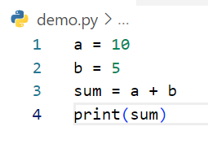
Write step following code below
Step | a | b | sum | output
1 | 10
2 | 10 | 5
3 | 10 | 5 | 15
4 | 10 | 5 | 15 | 15
Example

Slide 2
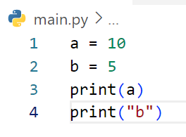
Write step following code below
Step | a | b | output
1 | 10
2 | 10 | 5
3 | 10 | 5 | 10
4 | 10 | 5 | b

Slide 3
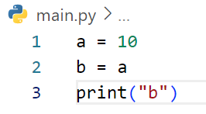
Write step following code below
Step | a | b | output
1 | 10
2 | 10 | 10
3 | 10 | 10 | b

Slide 4
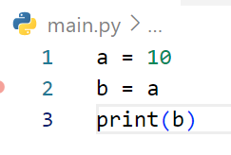
Write step following code below
Step | a | b | output
1 | 10
2 | 10 | 10
3 | 10 | 10 | 10

Slide 5
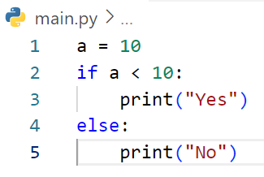
Write step following code below
Step | a | a < 10 | output
1 | 10
2 | 10 | False
3 | 10 |  | No

Slide 6
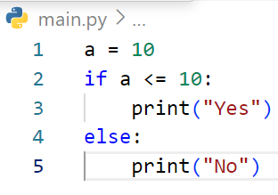
Write step following code below
Step | a | a <= 10 | output
1 | 10
2 | 10 | True
3 | 10 |  | Yes

Slide 7
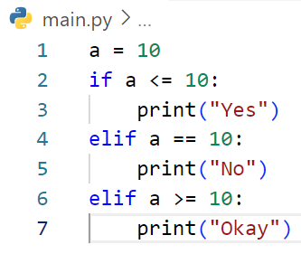
Write step following code below
Step | a | a <= 10 | a == 10 | a >= 10 | output
1 | 10
2 | 10 | True
3 | 10 |  |  |  | Yes

Slide 8
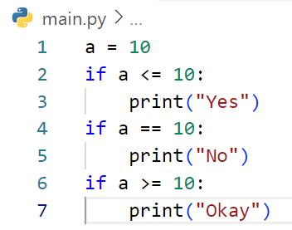
Write step following code below
Step | a | a <= 10 | a == 10 | a >= 10 | output
1 | 10
2 | 10 | True
3 | 10 |  |  |  | Yes
4 | 10 |  | True
5 | 10 |  |  |  | No
6 | 10 |  |  | True
7 | 10 |  |  |  | Okay

Slide 9
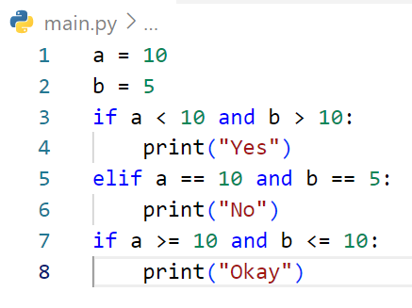
Write step following code below
Step | a | b | a < 10 | A == 10 or b == 5 | A>=10 or b<=10 | output
1 | 10
2 | 10 | 5
3 | 10 | 5 | False | True
4 | 10 | 5 |  |  |  | No
5 | 10 | 5 |  |  | True
6 | 10 | 5 |  |  |  | Okay

Slide 10
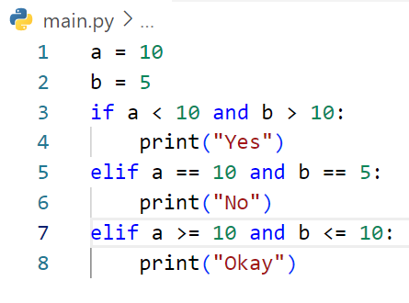
Write step following code below
Step | a | b | A < 10 and b > 10 | A == 10 and b == 5 | A >= 10 and b <= 10 | output
1 | 10
2 | 10 | 5
3 | 10 | 5 | False | True
 |  |  |  |  |  | No

Slide 11
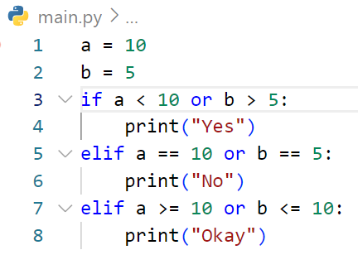
Write step following code below
Step | a | b | a < 10 or b > 5 | a == 10 or b == 5 | a >= 10 or b <= 10 | output
1 | 10
2 | 10 | 5
3 | 10 | 5 | False | True
4 | 10 | 5 |  |  |  | No

Slide 12
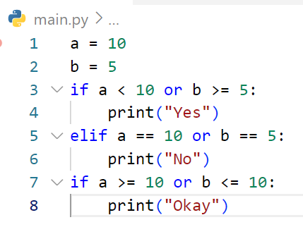
Write step following code below
Step | a | b | a < 10 or b >= 5 | a == 10 or b == 5 | a >= 10 or b <= 10 | output
1 | 10
2 | 10 | 5
3 | 10 | 5 | True
4 | 10 | 5 |  |  |  | Yes
5 | 10 | 5 |  |  | True
6 |  |  |  |  |  | Okay

Slide 13
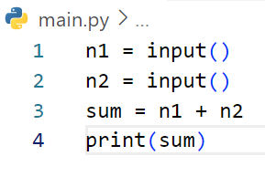
Write step following code below
Step | n1 | n2 | sum | output
1 | 3
2 | 3 | 5
3 | 3 | 5 | 35
4 | 3 | 5 | 35 | 35
# If user enter first : 3 and second 5

Slide 14
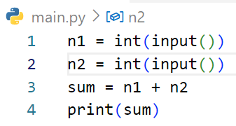
Write step following code below
Step | n1 | n2 | sum | output
1 | 3
2 | 3 | 5
3 | 3 | 5 | 8
4 | 3 | 5 | 8 | 8
# If user enter first : 3 and second 5

Slide 15
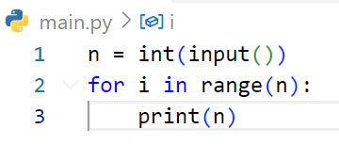
Write step following code below
Step | n | i | output
1 | 3
2 | 3 | 0
3 | 3 | 0 | 3
4 | 3 | 1
5 | 3 | 1 | 3
6 | 3 | 2
7 | 3 | 2 | 3
# If user enter : 3

Slide 16
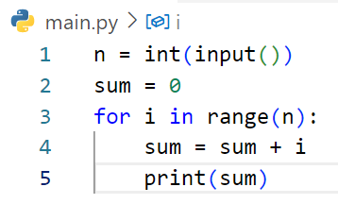
Write step following code below
Step | i | n | sum | output
1 |  | 3
2 |  | 3 | 0
3 | 0 | 3 | 0
4 | 0 | 3 | 0
5 | 0 | 3 | 0 | 0
6 | 1 | 3 | 0
7 | 1 | 3 | 1
8 | 1 | 3 | 1 | 1
9 | 2 | 3 | 1
10 | 2 | 3 | 3
11 | 2 | 3 | 3 | 3
# If user enter : 3

Slide 17
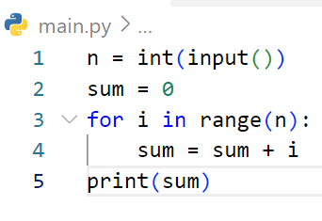
Write step following code below
Step | i | n | sum | output
1 |  | 2
2 |  | 2 | 0
3 | 0 | 2 | 0
4 | 0 | 2 | 0
5 | 1 | 2 | 0
6 | 1 | 2 | 1
7 | 1 | 2 | 1 | 1
# If user enter : 2

Slide 18
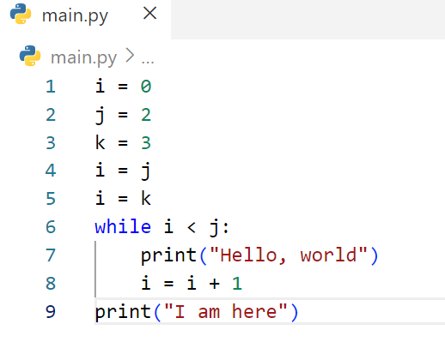
Write step following code below
Step | i | j | k | While i < j | output
1 | 0
2 | 0 | 2
3 | 0 | 2 | 3
4 | 2 | 2 | 3
5 | 3 | 2 | 3
6 | 3 | 2 | 3 | False
7 | 3 | 2 | 2 |  | I am here

Slide 19
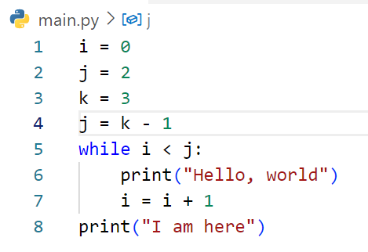
Write step following code below
Step | i | j | k | While i < j | output
1 | 0
2 | 0 | 2
3 | 0 | 2 | 3
4 | 0 | 2 | 3
5 | 0 | 2 | 3 | True
6 | 0 | 2 | 3 |  | Hello, world
7 | 1 | 2 | 3
8 | 1 | 2 | 3 | True
9 | 1 | 2 | 3 |  | Hello, world
10 | 2 | 2 | 3
11 | 2 | 2 | 3 | False
12 | 2 | 2 | 3 |  | I am here

Slide 20
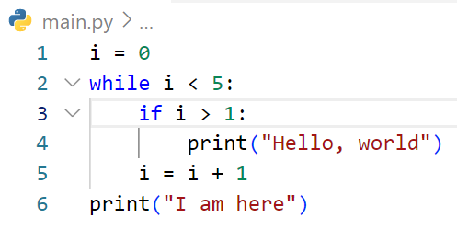
Write step following code below
Step | i | While i < 5 | i > 1 | output
1 | 0
2 | 0 | True
3 | 0 |  | False
4 | 1
5 | 1 | True
6 | 1 |  | False
7 | 2
8 | 2 | True
9 | 2 |  | True
10 | 2 |  |  | Hello, world
11 | 3
12 | 3 | True
13 | 3 |  | True
14 | 3 |  |  | Hellow, word
15 | 4
16 | 4 | True
17 | 4 |  | True
18 | 4 |  |  | Hello, world
19 | 5
20 | 5 | False
21 | 5 |  |  | I am here

Slide 21
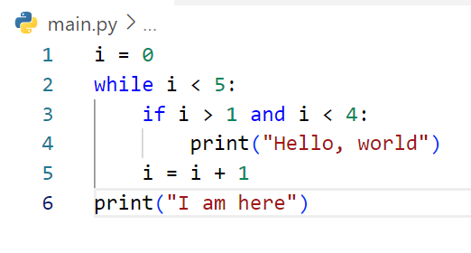
Write step following code below
Step | i | While i<5 | i < 1 and i < 4 | output
1 | 0
2 | 0 | True
3 | 0 |  | False
4 | 1
5 | 1 | True
6 | 1 |  | False
7 | 2
8 | 2 | True
9 | 2 |  | True
10 | 2 |  |  | Hello, world
11 | 3
12 | 3 | True
13 | 3 |  | True
13 | 3 |  |  | Hello, world
16 | 4
17 | 4 | True
18 | 4 |  | Flase
19 | 5
20 | 5 | False
21 | 5 |  |  | I am here

Slide 22
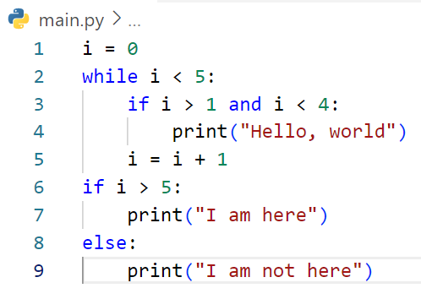
Write step following code below
Step | i | While i < 5 | i > 1 and i < 4 | i > 5 | output
1 | 0
2 | 0 | True
3 | 0 |  | False
4 | 1
5 | 1 | True
6 | 1 |  | False
7 | 2
8 | 2 | True
9 | 2 |  | True
10 | 2 |  |  |  | Hello, world
11 | 3
12 | 3 | True
13 | 3 |  | True
14 | 3 |  |  |  | Hello, world
15 | 4
16 | 4 | True
17 | 4 |  | Flase
18 | 5
19 | 5 | False
20 | 5 |  |  | Flase
21 | 5 |  |  |  | I am not here

Slide 23
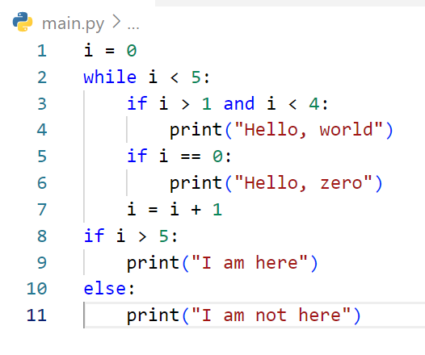
Write step following code below
Step | i | while i < 5 | i > 1 ans i <4 | i == 0 | I > 5 | output
1 | 0
2 | 0 | True
3 | 0 |  | False
4 | 0 |  |  | True
5 | 0 |  |  |  |  | Hello, zero
6 | 1
7 | 1 | True
8 | 1 |  | False
9 | 1 |  |  | False
10 | 2
11 | 2 | Trure
12 | 2 |  | True
13 | 2 |  |  |  |  | Hello, world
14 | 2 |  |  | False
15 | 3
16 | 3 | True
17 | 3 |  | True
18 | 3 |  |  |  |  | Hello, world
19 | 3 |  |  | False
20 | 4
21 | 4 | True
22 | 4 |  | False
23 | 4 |  |  | False
24 | 5
25 | 5 | False
26 | 5 |  |  |  | False
27 | 5 |  |  |  |  | I am not here

Slide 24
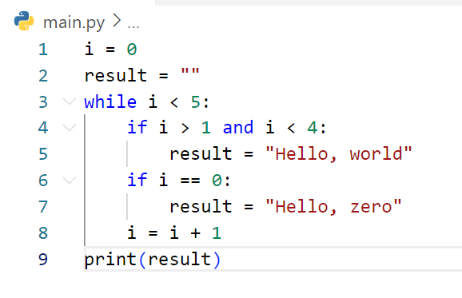
Step | i | result | While i < 5 | i > 1 and i < 4 | i == 0 | output
1 | 0 | “ “
2 | 0 | “ “ | True
3 | 0 | “ “ |  | False
4 | 0 | “ “ |  |  | True
5 | 0 | Hello, zero
6 | 1 | Hello, zero
7 | 1 | Hello, zero | True
8 | 1 | Hello, zero |  | False
9 | 1 | Hello, zero |  |  | False
10 | 2 | Hello,zero
12 | 2 | Hello, zero | True
13 | 2 | Hello, zero |  | True
14 | 2 | Hello, world
15 | 2 | Hello, world |  |  | False
16 | 3 | Hello, world
17 | 3 | Hello, world | True
18 | 3 | Hello, world |  | True
19 | 3 | Hello, world
20 | 3 | Hello, world |  |  | False
21 | 4 | Hello, world
22 | 4 | Hello, world | True
23 | 4 | Hello, world |  | False
24 | 4 | Hello, world |  |  | False
25 | 5 | Hello, world
26 | 5 | Hello, world | False
27 | 5 | Hello, world |  |  |  | Hello, world
28
Write step following code below

Slide 25
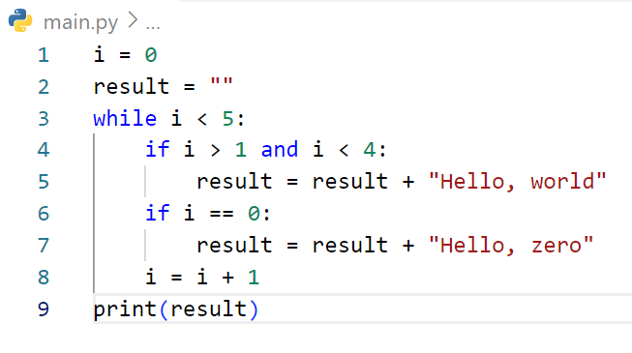
Step | i | result | While i<5 | i > 1 and i < 4 | i == 4 | output
1 | 0
2 | 0 | “ ”
3 | 0 | “ “ | True
4 | 0 | “ “ |  | False
5 | 0 | “ “ |  |  | True
6 | 0 | Hello, zero
7 | 1 | Hello, zero
8 | 1 | Hello, zero | True
9 | 1 | Hello, zero |  | False
10 | 1 | Hello, zero |  |  | False
11 | 2 | Hello, zero
12 | 2 | Hello, zero | True
13 | 2 | Hello, zero |  | True
14 | 2 | Hello, zeroHello, world
15 | 2 | Hello, zeroHello, world |  |  | False
16 | 3 | Hello, zeroHello, world
17 | 3 | Hello, zeroHello, world | True
18 | 3 | Hello, zeroHello, world |  | True
19 | 3 | Hello, zeroHello, worldHello, world
20 | 3 | Hello, zeroHello, worldHello, world |  |  | False
21 | 4 | Hello, zeroHello, worldHello, world
22 | 4 | Hello, zeroHello, worldHello, world | True
23 | 4 | Hello, zeroHello, worldHello, world |  | False
24 | 4 | Hello, zeroHello, worldHello, world |  |  | Flase
25 | 5 | Hello, zeroHello, worldHello, world
26 | 5 | Hello, zeroHello, worldHello, world | False
27 | 5 | Hello, zeroHello, worldHello, world |  |  |  | Hello, zeroHello, worldHello, world
Write step following code below

Slide 26
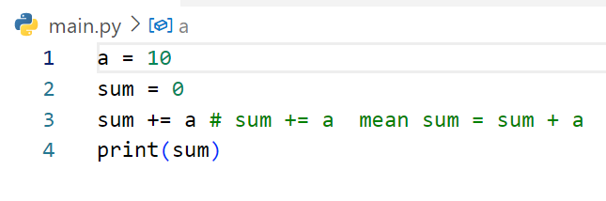
Write step following code below
Step | a | sum | output
1 | 10
2 | 10 | 0
3 | 10 | 10
4 | 10 | 10 | 10

Slide 27
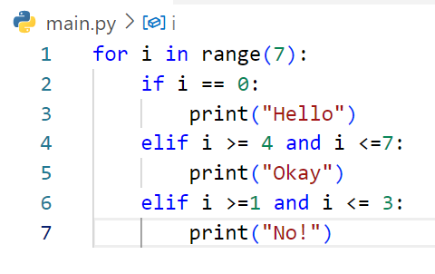
Write step following code below
Step | i | i == 0 | i >= 4 and i <= 7 | i >= 1 and i <= 3 | output
1 | 0
2 | 0 | True
3 | 0 |  |  |  | Hello
4 | 1
6 | 1 | False
7 | 1 |  | Flase
8 | 1 |  |  | True
9 | 1 |  |  |  | No!
10 | 2
11 | 2 | False
12 | 2 |  | False
13 | 2 |  |  | True
14 | 2 |  |  |  | No!
15 | 3
16 | 3 | False
17 | 3 |  | False
18 | 3 |  |  | True
19 | 3 |  |  |  | No!
20 | 3
21 | 4
22 | 4 | False
23 | 4 |  | True
24 | 4 |  |  |  | Okay
25 | 5
26 | 5 | False
27 | 5 |  | True
28 | 5 |  |  |  | Okay
29 | 6
30 | 6 | False
31 | 6 |  | True
32 | 6 |  |  |  | Okay

Slide 28
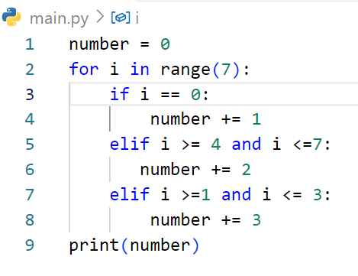
Write step following code below
Step | i | i == 0 | i >= 4 and i <= 7 | i >= 1 and i <= 3 | number | output
1 |  |  |  |  | 0
2 | 0 | True |  |  | 0
3 | 0 |  |  |  | 1
4 | 1 | False |  |  | 1
5 | 1 |  | False |  | 1
6 | 1 |  |  | True | 1
7 | 1 |  |  |  | 4
8 | 1 |  |  |  | 4
9 | 2 | False |  |  | 4
10 | 2 |  | False |  | 4
11 | 2 |  |  | True | 4
12 | 2 |  |  |  | 7
13 | 3 |  |  |  | 7
14 | 3 | False |  |  | 7
15 | 3 |  | False |  | 7
16 | 3 |  |  | True | 7
17 | 3 |  |  |  | 10
18 | 4 | False |  |  | 10
19 | 4 |  | True |  | 10
20 | 4 |  |  |  | 12
21 | 5 |  |  |  | 12
22 | 5 | False |  |  | 12
23 | 5 |  | True |  | 12
24 | 5 |  |  |  | 14
25 | 6 | False |  |  | 14
26 | 6 |  | True |  | 14
27 | 6 |  |  |  | 16
28 | 6 |  |  |  |  | 16

